Slide 1

Future leaders
Future Leaders hold different positions of responsibility in our school.
They will want to use our school values to make the school and themselves even better.

Slide 2

Honesty
Doing and saying the right thing
COnversation lEADERS
Be able to talk with other pupils and grown ups about our school
2 pupils from each class for the term
Interview

Slide 3
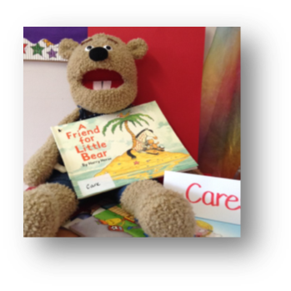

Care
Look after myself and others
Eco leaders
Lead on keeping our environment clean & tidy
inside and out
2 pupils from each class for the year
Volunteer & each class to vote

Slide 4

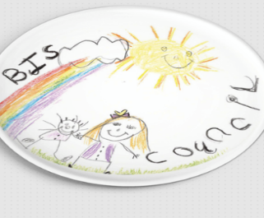
Perseverance
Work at something even if it’s tricky
School Council LEADERS
Ideas to make our school even better
Help raise money
Give assemblies
2 pupils from each class for the year
Volunteer & each class to vote

Slide 5
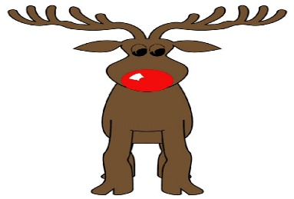
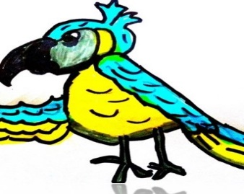
Responsibility
Show you can be trusted to make good choices
Online-safety leaders
Encourage safe behaviour online and offline
Give assemblies
2 pupils from each class for the year
Volunteer & each class to vote

Slide 6


Co-operate
Work together
CLASSROOM & Lunchtime LEADERS
Help to set up & tidy the rooms
2 pupils from each class for the ½ term
Volunteer & each class to vote

Slide 7

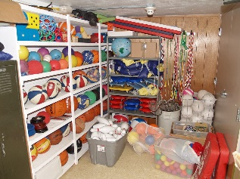
Respect
Thoughtful of other’s thoughts & feelings
Play LEADERS
Set up and tidy away sports equipment
Tidy the playground.
2 pupils from each Year 1 & Year 2 for the term
Volunteer & each class to vote

Slide 8
Future leaders
To be a future leader you need to want to:
Make your own decisions
  see the good ideas & down side of your ideas
Solve problems
  Come up with solutions; ask for help if needed
Teamwork
  - Work and co-operate with others

Slide 9
Future leaders
Dream Big
  Set a goal and work at making it happen
Improve communication skills
  Share your ideas and opinions; listen to others share theirs
Keep your promises
  Stick with it and stay committed to your leadership role
Follow the rules
  - Stick to the rules or face the consequences for not following them

Slide 10
Next steps…
Remind yourself which leadership roles there are
Decide if you wish to be a leader
Tell your teacher your decision
Take part in the voting (and interviews)

