Slide 1

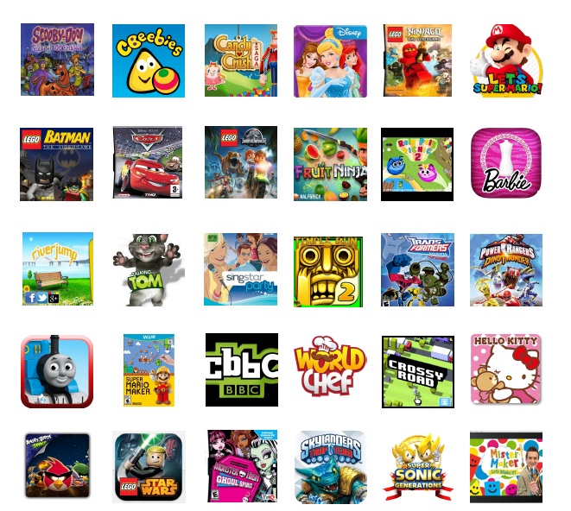
How many of these does your child use?

Slide 2

Welcome to our e-Safety workshop for Parents
By the end of this session:
Know key e-Safety messages your child will learn at Bilton Infant School
How these will safeguard your child, even though technologies are constantly changing
Ways to support your child being e-safe at home

Slide 3
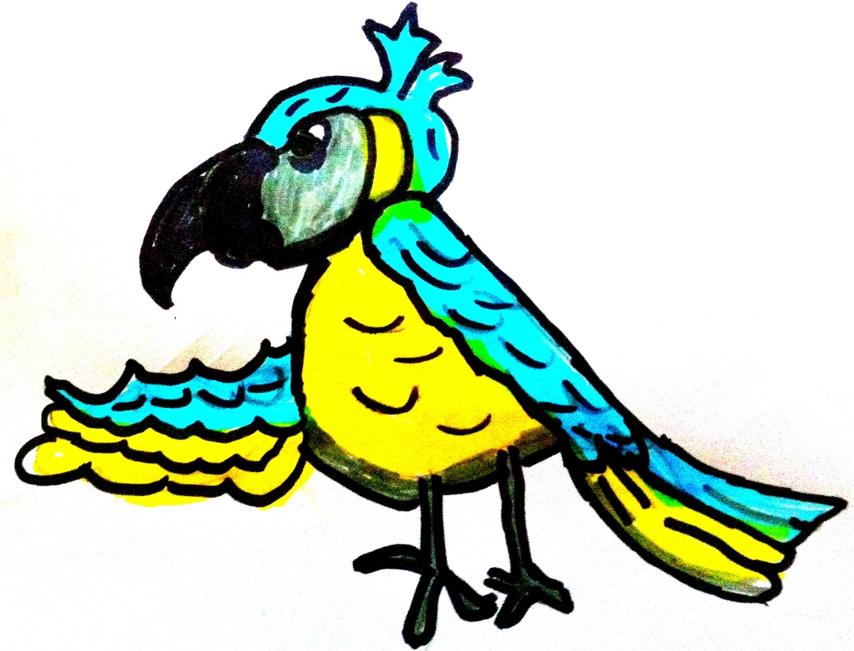
Meet PEGI the parrot, our new e-Safety character.

Slide 4
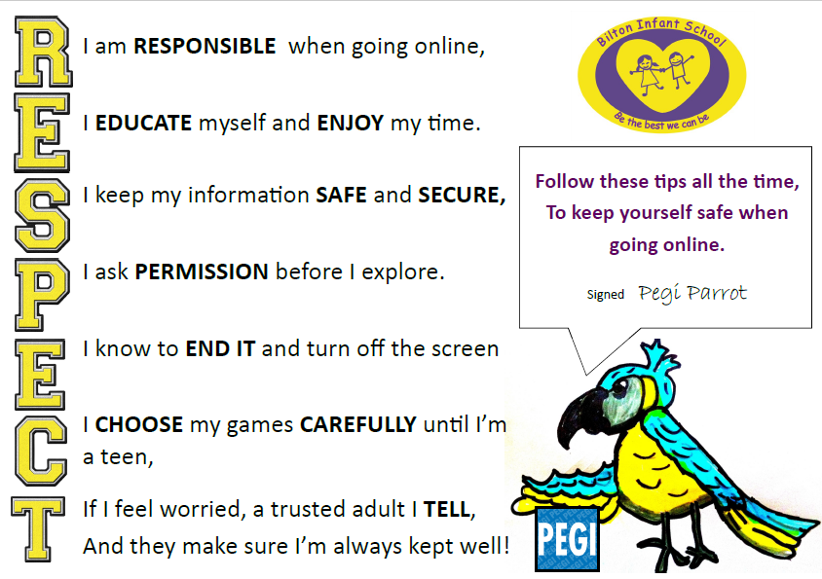

Slide 5
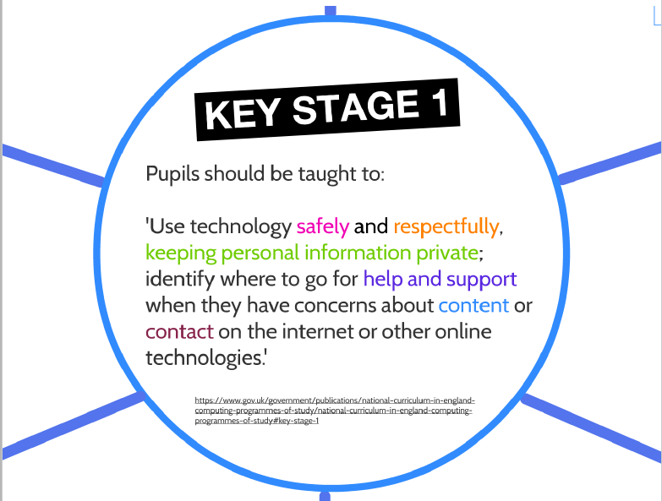

Slide 6



I am RESPONSIBLE when going online,
Handling equipment responsibly.
Communicating online e.g. email, Facetime, Skype
Following safe practices when going onto the Internet.
Following acceptable use policy.
I EDUCATE myself and ENJOY my time.
I keep my information SAFE and SECURE,
I ask PERMISSION before I explore.
I know to END IT and turn off the screen
I CHOOSE my games CAREFULLY until I’m a teen,
If I feel worried, a trusted adult I TELL,
And they make sure I’m always kept well!
I am RESPONSIBLE when going online,
I EDUCATE myself and ENJOY my time.
I keep my information SAFE and SECURE,
I ask PERMISSION before I explore.
I know to END IT and turn off the screen
I CHOOSE my games CAREFULLY until I’m a teen,
If I feel worried, a trusted adult I TELL,
And they make sure I’m always kept well!

Slide 7


I EDUCATE myself and
ENJOY my time.
Safe searching of Internet to find information.
Learn how to email to gain information
Use websites safely for learning new skills.
Playing games
and using apps.
I EDUCATE myself and ENJOY my time.
I keep my information SAFE and SECURE,
I ask PERMISSION before I explore.
I know to END IT and turn off the screen
I CHOOSE my games CAREFULLY until I’m a teen,
If I feel worried, a trusted adult I TELL,
And they make sure I’m always kept well!
I am RESPONSIBLE when going online,
I EDUCATE myself and ENJOY my time.
I keep my information SAFE and SECURE,
I ask PERMISSION before I explore.
I know to END IT and turn off the screen
I CHOOSE my games CAREFULLY until I’m a teen,
If I feel worried, a trusted adult I TELL,
And they make sure I’m always kept well!

Slide 8

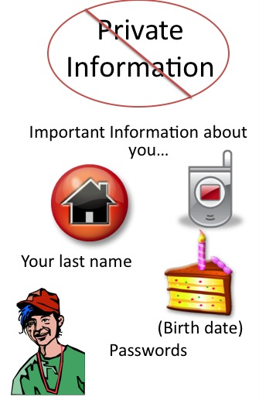
I keep my information
SAFE and SECURE,
Protecting identities by not sharing private information.
Asking for consent before taking photos of others.
Learning about copyright.
Use of passwords and
why they are important.
I EDUCATE myself and ENJOY my time.
I keep my information SAFE and SECURE,
I ask PERMISSION before I explore.
I know to END IT and turn off the screen
I CHOOSE my games CAREFULLY until I’m a teen,
If I feel worried, a trusted adult I TELL,
And they make sure I’m always kept well!
I am RESPONSIBLE when going online,
I EDUCATE myself and ENJOY my time.
I keep my information SAFE and SECURE,
I ask PERMISSION before I explore.
I know to END IT and turn off the screen
I CHOOSE my games CAREFULLY until I’m a teen,
If I feel worried, a trusted adult I TELL,
And they make sure I’m always kept well!

Slide 9


I ask PERMISSION
before I explore.
Ask an adult before using any device.
Adult checks website / app is ok for child to use.
School asks parents’ permission before using photos.
Asking permisssion to take another person’s photo.

Slide 10


I know to END IT and
turn off the screen
Turn off screen if have contact or see content which gives a worried feeling.
Playing games in moderation – knowing when to stop after given period of time.
Stop using device when grown up asks me to.

Slide 11




I CHOOSE my games CAREFULLY until I’m a teen,
PEGI ratings on games help to keep us safe. They tell us how old we need to be to play them.
Some games let us chat to people we don’t know.

Slide 12



If I feel worried, a trusted adult I TELL,
And they make sure I’m always
kept well!
Talk to trusted adult if they encounter material that concerns them.
Use network hands of trust
Know where to go for help and support.

Slide 13
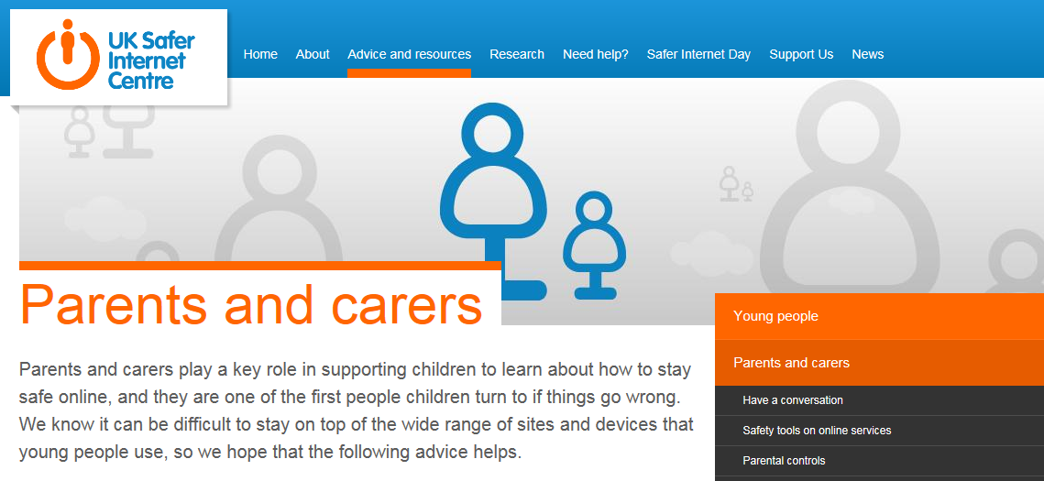
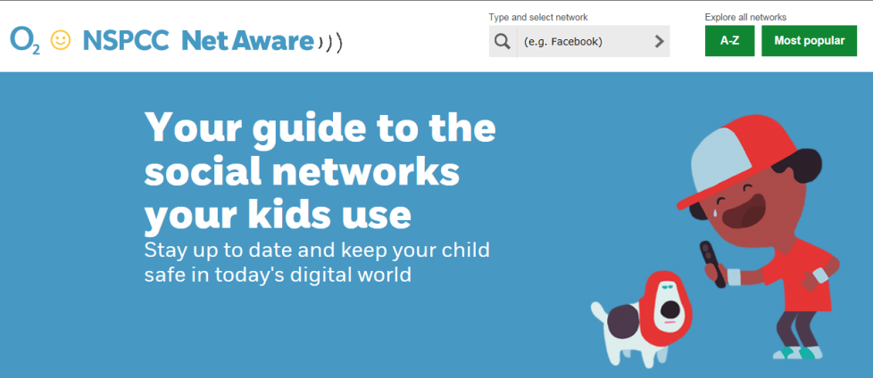
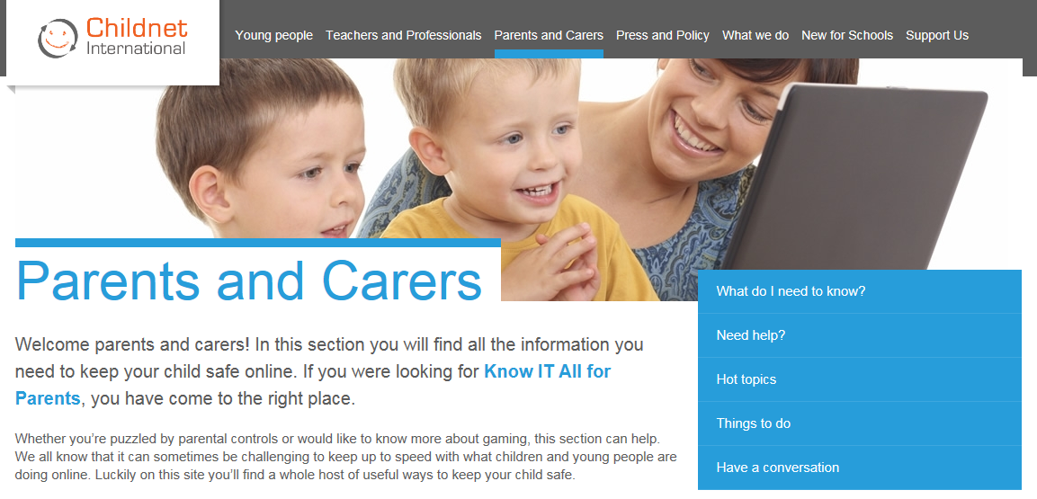
http://www.saferinternet.org.uk
https://www.nspcc.org.uk/
https://www.net-aware.org.uk/
http://www.childnet.com

Slide 14
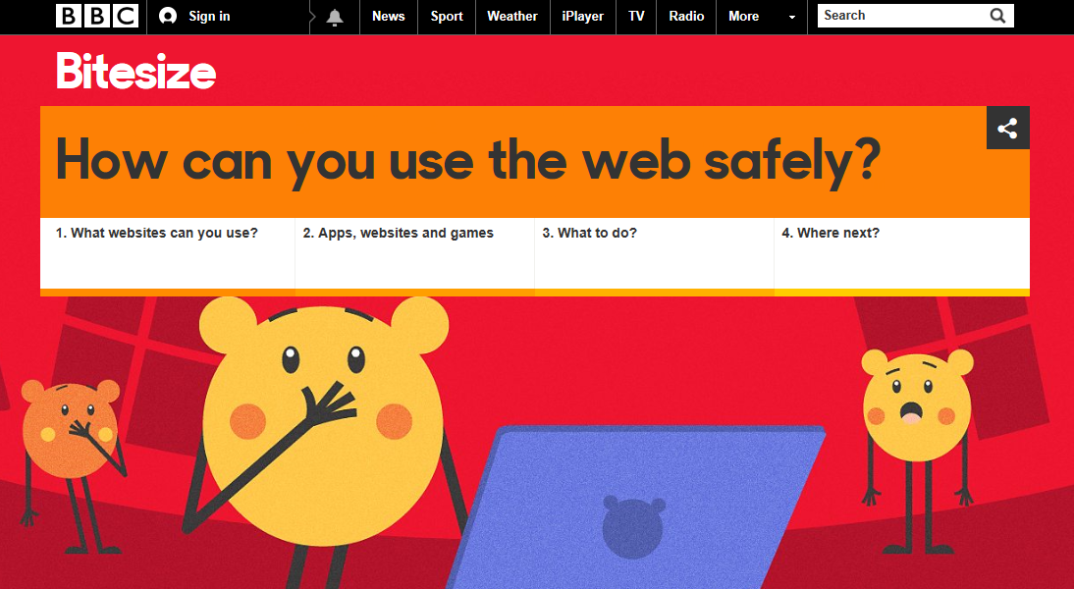
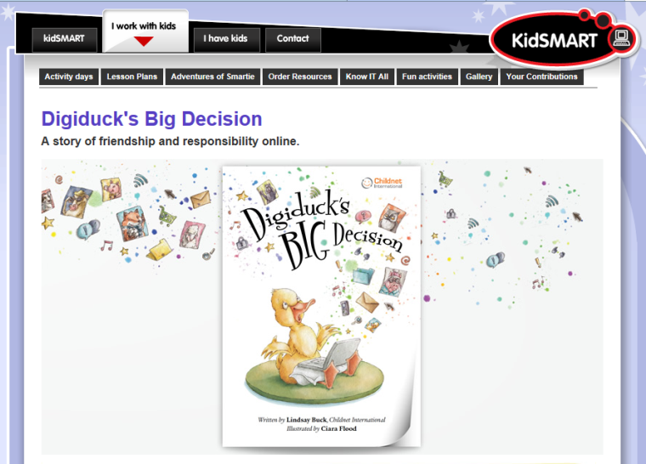

http://www.bbc.co.uk/guides/zym3b9q
http://www.kidsmart.org.uk
http://www.penguinpig.co.uk/

