Slide 2

PE and sport premium monitoring and tracking form
It is intended that this template should be used as preparation for the completion of the statutory DfE PE and sport premium digital expenditure reporting return. You can upload data (including swimming) from this template onto this platform once it becomes accessible.
The template is a working document that you can amend and update during the year.
Before you decide how you are going to use the funding for this academic year you should reflect and evaluate the impact of your use of you PE and sport premium funding in 2024/25.
You should use your evaluation of last year’s funding to help you decide what to do this academic year, how you will do it, and what impact you expect it to have.
All spending of the funding must conform with the terms outlined in the conditions of grant
The summative digital expenditure reporting from June 2026 will continue to include swimming and water safety information. PE and sport premium funding can be used to provide top-up lessons, where necessary, to ensure pupils meet national curriculum swimming requirements
To ensure funding is used effectively and based on your school’s needs; guidance and examples of best practice across schools can be found here.
You must use the funding to make additional and sustainable improvements to the PE and sport in your school.
You must develop and add to the PESSPA activities that your school already offers.
Useful Links:
PE and sport premium for primary schools - GOV.UK
PE and sport premium: conditions of grant 2025 to 2026 - GOV.UK

Slide 3
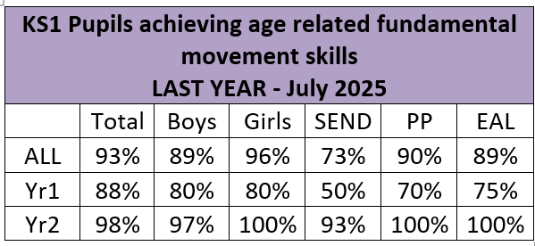
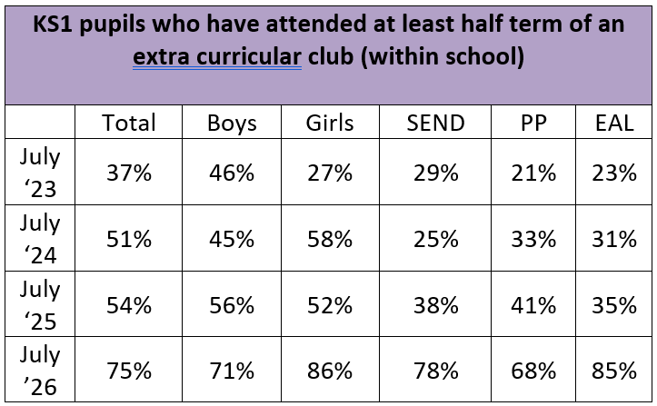
Review of the last academic year (2024/2025)
Take some time to reflect on your intent, implementation and impact from last academic year to celebrate your wins but to also think about improvements for the year ahead.
You do not need to complete every box. Just record the information that is key to your school's priorities and areas of focus.
Remember - Be clear about how you focused spending on key groups such as SEND, girls and disadvantaged pupils.

Slide 4
Review of the last academic year (2024/2025)
Key areas as outlined in PE and sport premium guidance | What went well? Supporting evidence? | What didn't go well? Supporting evidence?
1. Increasing confidence, knowledge and skills of all staff in teaching PE and sporting activities prioritising CPD and training where needed | All teachers highly focusing on fundamental movement skills. Learning walk evidence Use of Jasmine portal Termly summative data (see previous page) All teachers trained in Real PE, Real Gym and Real Dance. Further CPD now available on Jasmine portal. Staff CPD log. PE lead attended termly subject leader meetings to ensure up to date with current messages and information. | No whole school PE CPD this year to continue to raise standards.
2. Increasing engagement of all pupils in regular physical activity and sporting activities | Weekly Real PE lessons happened every week all year due to having SSP coach in to support. SSP coach particularly targeting children who not yet met age related to practice specific skills e.g. balance, skipping, hopping. SSP coach Almost all children in Nurture provision accessing Real PE lessons for part of lesson and skills followed up with TA during week. | Provide highly active REAL PE lessons to enable all pupils to develop their fundamental movement skills. Learning walks shows varying levels of activity in lessons.

Slide 5
Review of the last academic year (2024/2025)
Key areas as outlined in PE and sport premium guidance | What went well? Supporting evidence? | What didn't go well? Supporting evidence?
3. Raising the profile of PE and sport across the school, to support whole school improvement | Further developing Opal Play programme to support children’s active play and develop pupils’ wide range of active play skills. 100% of children love Opal Play and wouldn’t want it to stop. Staff view ‘The children are highly active and seem so happy’ Huge reduction in behaviour incidents both during and after lunchtime. Parent sessions well attended – over 40 families attended each Play afternoon held through the year. | Opal Play Working Group Changeover of staff during Summer Term due to working group members leaving the school. Difficulties in meeting half termly due to working group time commitments and roles within school.
4. Offer a broader and more equal experience of a range of sports and physical activities to all pupils and ensure equal access to sport for boys and girls | Use of SSP coach to provide a range of activities available to all through lunchtime provision Examples of sports offered – tennis, dodgeball, frisbee, athletic skills, yoga | Extra Curricular club provision Limited range of extra curricular clubs resulting in the same children often attending. Pupil resilience to attend a club outside of school hours. Staff capacity to provide extra curricular club provision. Providing targeted places for disadvantaged or vulnerable pupils within clubs. (38% SEND, 41% PP, 35% EAL compared to 54% all)
5. Increasing participation in competitive sport | 100% of KS1 had attended at least 1 PE Festival last year. 97% of KS1 attended 2 or more festivals. Increased offer to include Change for Life Festival for 5 Nurture provision children to attend. | N/A

Slide 6
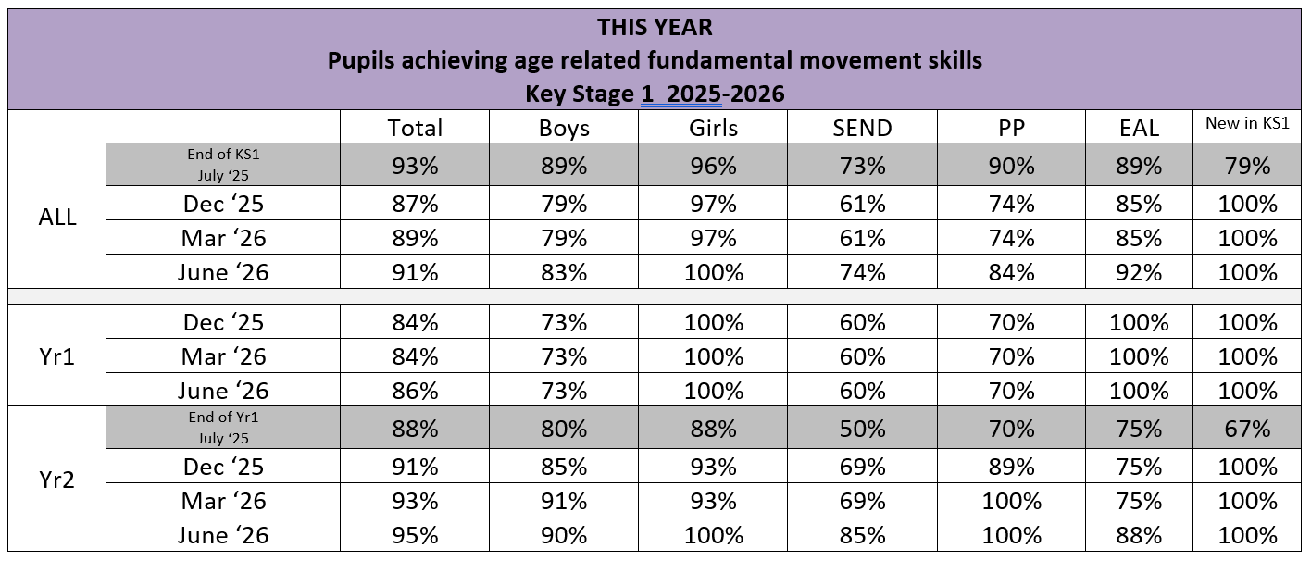
Plan, monitor and evaluate (2025/2026)
Please aim to use this as a live working document through the year.
Keep returning to this to evidence adaptations and progress made through the PESSPA opportunities you provide.
There is no set number of objectives you must have.
Make as many or as few as you see fit that will support your aims for the year ahead.
Consider which of the 5 key areas improvements will be focusing on:
1. Increasing confidence, knowledge and skills of all staff in teaching PE and sporting activities prioritising CPD and training where needed.
2. Increasing engagement of all pupils in regular physical activity and sporting activities
3. Raising the profile of PE and sport across the school, to support whole school improvement
4. Offer a broader and more equal experience of a range of sports and physical activities to all pupils and ensure equal access to sport for boys and girls
5. Increasing participation in competitive sport

Slide 7
Your objective: 3. Raising the profile of PE and sport across the school, to support whole school improvement
 | Intent - what is your objective? | Implementation - How will you achieve this? | Impact - What do you hope to see? | Supporting evidence
Plan and monitor (Complete now and monitor) | Further develop Opal Play programme to include a wider range of sports / activities for all pupils. | Embed Opal Play policy within school to ensure shared values and practice to achieve Platinum status by June 2026. Purchase / Source a broader range of equipment for use in both PE lessons and during outdoor play. | At least 10 clearly defined areas within Opal Play, all regularly used and accessed independently by children, all providing different skills. Working group meets at least half termly to ensure Opal Play continues to develop and support current pupil needs. All of the Play team, along will teachers & TAs are trained in risk benefit management and play types to ensure high quality support of physical activity Clear routes for sourcing resources e.g. parent donations, links with local businesses, use of social media. | Monitoring visits from our Opal Play Mentor (Opal Play team) Physical setup of Outdoor space. Opal Play action plan & RBAs (risk benefit analysis) CPD log of training opportunities. Regular donations of equipment Log of equipment purchased to support Opal Play development.
 | What impact have you seen? | Are the improvements sustainable? How? | Supporting evidence | Approx. cost
Evaluate (Complete in July) | Achieved OPAL Platinum Status with 93% score. Lunchtime behaviour incidents very rare – space and resources have meant children are purposefully engaged. Bilton Beach project given OPAL a focal point. Raised profile of school and had number of local schools come to see our provision. | Resources largely donated so continue to have OPAL drop off and regular shout outs to families. Areas now built / set up so annual community days to maintain. Continue working group to ensure provision is reviewed regularly. Play Co-Ordinator continue to train staff at least annually. Termly lunchtime learning walks to evaluate and review provision. Regular play assemblies to promote values through OPAL. | 100% children surveyed love OPAL and would not like to have playtimes without it. Hosted 3 OPAL PLAY for families after school and 2 Parent Play afternoons. OPAL regularly mentioned within both staff and parent voice as a huge positive factor for our school. Behaviour logs show hardly any incidents for whole academic year. | Physical Resources - £800 OPAL / Staff CPD - £695

Slide 8
Your objective: 4. Offer a broader and more equal experience of a range of sports and physical activities to all pupils and ensure equal access to sport for boys and girls
 | Intent - what is your objective? | Implementation - How will you achieve this? | Impact - What do you hope to see? | Supporting evidence
Plan and monitor (Complete now and monitor) | Increase participation in extra-curricular activities, especially SEND, PP and EAL children. | Provide a broader range of opportunities through use of PE Apprentice at lunchtimes, liasing with external club providers and providing a wider range of in house clubs. Target specific families directly to discuss barriers to attending specific clubs. Use TA Apprentice within BASC at least 2 evenings a week to provide regular physical activity to children having longer hours in school. | Aim for at least 65% of pupils attending an extra curricular club. (July 2025 = 54%) Aim for at least 50% of SEND, PP and EAL children attending an extra curricular club. (July 2025 = SEND 38%, PP 41%, EAL 35%) | Extra curricular club registers PE lead monitoring of clubs CPOMs logs of any conversations with parents of targeted families Discussion with coaches / parents to find out what is working / what needs to be different.
 | What impact have you seen? | Are the improvements sustainable? How? | Supporting evidence | Approx. cost
Evaluate (Complete in July) | Huge increase in uptake for extra-curricular clubs - up 21% on 2025. 15+ clubs been offered this academic year. SEND uptake up 40% PP uptake up 27% EAL uptake up 50% 93% of Year 2 cohort attended club this year. 46% of KS1 children attended 2 or more clubs. More active BASC sessions – especially 2 nights per week. | Continue to review and add to current club offer (internal school staff running clubs) Add question on annual parent surveys to review club offer at least annually. Target vulnerables through free clubs and ones held throughout the day. Train up another member of the lunch team to run sporting activities as part of OPAL play. | Club data & pupil tracking of attendance. Pupil voice Parent surveys | PE Apprentice - £3000 SSP - £750

Slide 9
Your objective: 1: The engagement of all pupils in regular physical activity.
 | Intent - what is your objective? | Implementation - How will you achieve this? | Impact - What do you hope to see? | Supporting evidence
Plan and monitor (Complete now and monitor) | Continue to target pupils not yet achieving fundamental movements skills, to ensure almost all pupils catch up. | Hire TA Apprentice with PE Specialism to support lowest 20% in all PE lessons (whilst teacher still delivers lesson) Use TA Apprentice to provide short intervention sessions on fundamental movement skills to targeted pupils. | Strive for almost all pupils to meet age related expectations in fundamental movement skills. | Termly data linked to fundamental movement skills. Learning walks to see lessons in practice. Monthly monitoring of PE Apprentice linked to lesson support, interventions and lunchtime activities.
 | What impact have you seen? | Are the improvements sustainable? How? | Supporting evidence | Approx. cost
Evaluate (Complete in July) | 3x weekly gross motor intervention groups impacted on in crease in children meeting ARE for handwriting. 42/44 Year 2 children have met ARE in fundamental movement skills. 100% PP children met ARE by end of KS1. Increase in children meeting ARE during year in all vulnerable groups. | Ensure Gross motor interventions continue with TA once apprentice contract is up. Ensure vulnerable pupils continue to be supported to develop their fundamental movement skills. Continue to track children meeting ARE using Bromcom system. | Termly data Learning walks – PE lessons, intervention sessions Impact for children in Squiggle Intervention on their handwriting | Jasmine PE portal - £695 PE Apprentice - £8,500

Slide 10
Your objective: 5: Increased participation in competitive sport
 | Intent - what is your objective? | Implementation - How will you achieve this? | Impact - What do you hope to see? | Supporting evidence
Plan and monitor (Complete now and monitor) | Maintain high levels of participation in PE festivals for new cohort of pupils. | Ensure pupils have termly access to PE festivals, across Key Stage 1. | Strive for 100% of KS1 pupils accessing at least 2 PE festivals this year. | Monitoring of which children have attended which festivals.
 | What impact have you seen? | Are the improvements sustainable? How? | Supporting evidence | Approx. cost
Evaluate (Complete in July) | 100% of KS1 pupils have accessed at least 1 PE festival this academic year. 96% of KS1 pupils have attended 3 PE Festivals – cricket, infant agility, football 5 Nurture pupils had additional change for life festival. | Work with local federation of schools to continue to provide competitive festivals in the future. | Photographs and pupil voice from festivals. Data from festivals showing how many and diversity of participation. | Transport to festival - £420 SSP - £1500

Slide 11
Your objective: 3. Raising the profile of PE and sport across the school, to support whole school improvement
 | Intent - what is your objective? | Implementation - How will you achieve this? | Impact - What do you hope to see? | Supporting evidence
Plan and monitor (Complete now and monitor) | Raise profile of physical activity to all stakeholders within school. | Celebrate PE and Opal Play through fortnightly assemblies. Celebrate PE and Opal Play through weekly round up and social media. | Parents can talk about physical activity and opportunities within school. High attendance to events linked to physical activity e.g. Opal Parent afternoons, Sports Morning Highly positive pupil voice linked to physical activity. | Parent surveys Pupil surveys Attendance registers for Opal Play, Sports morning, other opportunities.
 | What impact have you seen? | Are the improvements sustainable? How? | Supporting evidence | Approx. cost
Evaluate (Complete in July) | PE / competitive sport / Opal Play celebrated regularly through newsletters and Social Media. Local Press release – Platinum Award Play Assemblies have huge impact on both pupils and staff to ensure consistency. | Continue to celebrate acheivements to wider community. Move to Monthly Opal Play evenings for families. | Social Media posts Weekly Round-Ups Press Release Photos / data to show engagement in family events. Opal Play display with pupil, parent voice. | Staff CPD (SSP) - £500 Trophies / Awards (SSP) - £200

